Slide 1
Presentation Outline
Part A Application of Artificial Intelligence (AI)
CSP - Travelling Problem
Part B Game Algorithm - Vacation Problem

Slide 2
PART A (i)
Applications of Artificial Intelligence

Slide 3





Applications of AI: List of Industries
Finance Industry
Health Industry
Visual Industry
Military
Computational Intelligence and Games

Slide 4



Applications of AI: Finance Industry
Authors
Saud M. Al-Fattah
Problem Forecasting oil-price volatility
Technique Used GANNATS model
A combination of genetic algorithm, artificial neural network, and data mining time-series model
Overall model prediction accuracy of 84% (training, validation, test)

Slide 5
Applications of AI: Health Industry
Authors
Tien Yin Wong, MD, PhD; Neil M. Bressler, MD
Problem The number of resources needed to address the potential number of patients with the
disease
Technique Used Diabetic retinopathy screening software based on deep learning techniques
For detecting referable diabetic retinopathy
Used large data sets of images to train the algorithm

Slide 6
Applications of AI: Visual Industry
Authors
David Ha, Douglas Eck
Problem Most of the work thus far has been targeted towards modelling low resolution, pixel images. Humans do not understand the world as a grid of pixels, only abstract concepts
Technique Used Sequence-to-Sequence Variational Autoencoder
using RNN as a coding/decoding mechanism
Receives a latent vector that characterizes the original picture
Decoder can extract a drawing from the vector, which can be altered later on

Slide 7
Applications of AI: Military
Authors
Nicholas Ernest, David Carroll, Corey Schumacher, Matthew Clark, Kelly Cohen and Gene Lee
Problem Delays in decision making for a remote controlled aircraft in an air to air combat scenario
Technique Used Genetic Fuzzy Tree
A collection of Fuzzy Inference System
Enables breakdown of problems to smaller solution space for quicker reactions

Slide 8
Applications of AI: Computational Intelligence and Games
Authors
Max Jaderberg, Wojciech M. Czarnecki, Iain Dunning, Luke Marris, Guy Lever, Antonio Garcia Castañeda
Problem End to end reinforcement learning does not succeed in training agents in multiagent games
Technique Used Population based reinforcement learning
Each agent learns its own internal reward signal and rich representation of the world for reinforcement learning
Stabilizes the learning process in a partially observable multiagent environment

Slide 9
PART A (ii)
CSP - Travelling Problem

Slide 10
Constraint Satisfaction Problem -
Recap of Vacation Problem
Solve vacation planning with fixed amount of money and duration:
You have a fixed amount of money.
You can stay in hotels with specific star rating.
You can eat food of price range.
You can visit minimum of 2 tourist spots.
You can travel in any kind of transportation you preferred, but within certain budget.
Notes:
give a short recap on what constraints that bounded our vacation problem
(preferably 10 seconds max)

Slide 11
Constraint Satisfaction Problem
Fixed Parameters:
Maximum Allocated Budgets:
RM 2500
Number of Days of Travelling:
4
Notes:
introduce the fixed parameters
highlight that the different results can be generated with different parameters

Slide 12
Constraint Satisfaction Problem - Constraint function
Given parameter (hotel_choice, tourist_spot_choice, foods_choice, transportation_choice): HB = hotels[hotel_choice][ppn] * days_of_travel List of TS = Get list from choose(tourist_spot, tourist_spot_choice) TB = Sum of List of tourist spot[price] List of F = Get list from choose(foods, foods_choice) FB = Sum of List of foods[price] List of R = Get list from choose(transportation, transportation_choice) RB = Sum of (List of transportation[price] * days_of_travel) Total budget = HB + TB + FB + RB Return (Total budget < Budget) AND (Length of TS > 2) AND (Length of F > 0)
Notes:
introduce the fixed parameters
highlight that the different results can be generated with different parameters

Slide 13
Constraint Satisfaction Problem - Sample solution
Total Expenditure: RM 1187.00
Sunway Velocity Hotel → RM 964 per 4 nights
Foods:
Malay (RM 7 - 20) → RM 52 Average per 4 days
Tourist Spot:
Paradise Park Farm (RM63), Sunway Lagoon (RM 108) → RM 171
Transportation:
None
Notes:
also, explain what is the problem with this kind of solution

Slide 14
Constraint Satisfaction Problem - Improvements
Domain filtering
Example: Da = { 1,2 }, Db = { 1,2,3 }
Constraint: a < b
Value 1 can be safely removed from Db.
Notes:
In our case, our ultimate goal is to have total cost ⩽ total budget allocated for a fixed number of days. Let’s take the example of hotel. The price per day(ppd) for a hotel * number of days should not exceed half the budget allocated. This is a simple logic because if hotel cost itself exceed half the budget, there will be no room for values of other variables since they will definitely exceed the budget. Hence, we can perform some early filtering to only include particular index of our variable list that satisfy the aforementioned condition. This must be applied to all variables before extracting the solution.

Slide 15
Constraint Satisfaction Problem - Improvements
Arc consistency
We say that a constraint is arc consistent (AC) if for any value of the variable in the constraint there exists a value (a support) for the other variable(s) in such a way that the constraint is satisfied (we say that the value is supported).
Notes:
introduce the fixed parameters
highlight that the different results can be generated with different parameters

Slide 16
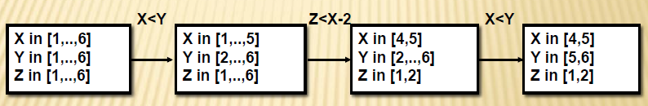
Constraint Satisfaction Problem - Improvements
How to establish arc consistency in a CSP?
Every constraint must be made AC!
Example: X in [1, . . , 6], Y in [1, . . ,6], Z in [1, . . ,6], constraint: X<Y, Z<X-2
Notes:
Filtering through every constraint just once is not enough. Hence, filtering must be repeated until any domain is fully arc consistent.
In our case, this is an extension of domain filtering. We want a solution such there there exist at least two choices for each domain variable. We do not want a vacation with only accomodation but no transportation, food, etc.. We do have a condition implying this in our constraint. Filtering through every constraint just once is not enough. Hence, filtering must be repeated until any domain is fully arc consistent. In our case, this is an extension of domain filtering. We want a solution such there there exist Filtering through every constraint just once is not enough. Hence, filtering must be repeated until any domain is fully arc consistent. In our case, this is an extension of domain filtering. We want a solution such there there exist at least two choices for each domain variable. We do not want a vacation with only accomodation but no transportation, food, etc.. We do have a condition implying this in our constraint.

Slide 17
PART B
Genetic Algorithm - Vacation Problem
Notes:
explain why microbit was cancelled

Slide 18

Genetic Algorithm Fitness Function
Total Spending of the Solution
Number of Options in the Solution
Fitness Score =
Notes:
The total cost and number of options for every solution of an individual is extracted from total_cost_and_options()
Then, the fitness score of each individual is derived from fitness_function()
The cost of is calculated by total cost/no of options
The higher the cost, the more expensive it is and the more number of options there are, the cheaper it is
The optimisation we are looking for is with the least cost and the highest number of options
Scores are then paired with their respective individual in pair_population_fitness()
Sort_by_fitness() is used to sort the scores of the individuals in the population in ascending order of cost
The highest score (lowest cost) will be at the top
Get_population_fitness() is to calculate the average score of the population

Slide 19

Genetic Algorithm Evolve
Default values used are:
Size of population = 500
Number of evolutions = 50
Retain = 0.5
Radiation = 0.4
Mutate_once = False
Notes:
Pop - The size of population
Target - Maximum number of population
Retain - Percentage of the population that will be used to evolve
Radiation - Percentage of mutation
Mutate_once
If true, if any of the offspring mutates then all of the offsprings will mutate
If false, each of the offsprings will have to undergo the probability set by radiation to mutate
Verbose - To display iteration status messages, in this case, if the offspring is the same as the parent (no need to explain this)

Slide 20

Genetic Algorithm Analysis Metric
The metrics used to measure the algorithm optimisation are:
Population Fitness Score
Average Total Budget in the Population
Average Number of Options in the Population
Notes:
(raflie: in this slide, explain about what is the purpose of measuring these metrics aka that is to verify convergence)
A set of solutions is an individual and the size of population is set by population_size and this would constitute the population
evolution_history to keep a history of the average scores of the new population
average_cost_and_options is to get the total cost and options for every individual of the population
average_cost is to store the average cost of the population
average_options is to store the average number of options in the population
The evolution will iterate up to the number_of_evolutions defined in the loop
Our fitness score to be as low as possible

Slide 21

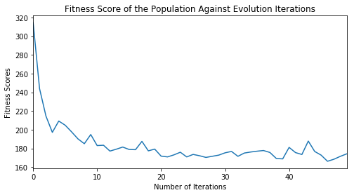
Genetic Algorithm Fitness Score Plot
Notes:
Using the fitness score stored in an evolution history variable:
Fitness score is plotted against the maximum number of iterations
The lower the better
More number of iterations does not always equal a lower fitness score (but then explain that around where the fitness value converges)
Why? (Ask Rafli) uwu
However the fitness score is on a downward trend which is an indicator that the algorithm is optimizing the problem

Slide 22
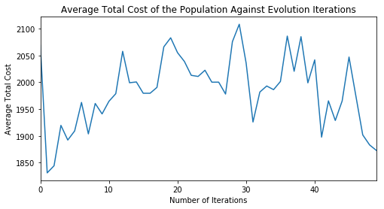
Genetic Algorithm Average Total Cost Plot
Notes:
Based on the average total cost taken by the total cost in a population over by the population size
It is plotted against the number of iterations
The lower the better
Generally it on a downward trend from 0th iteration to the n-th number of iteration (raflie: describe that in the last iterations, the total cost seems to not converges to any values)
However there are instances where the average total cost is higher than the initial total cost
(Probably) due to mutation

Slide 23
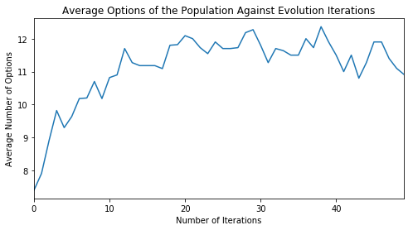
Genetic Algorithm Average Options Plot
Notes:
Using the total number of options over the size of population
Average options is obtained
It is plotted against number of iterations
The higher the better
Generally on an upward trend
No instances where the average options is below the initial average

Slide 24
Genetic Algorithm Sample Solution
Total Expenditure: RM 1752.00
Sunway Velocity Hotel → RM 964 per 4 nights
Foods:
Malay (RM 7 - 20), Chinese (RM 20 - 30), Seafood (RM20 - 30) → RM 304 Average per 4 days
Tourist Spot:
Paradise Park Farm (RM63), Petronas Twin Tower (RM 122), Garden of Nature (RM 121), Sunway Lagoon (RM 108) → RM 414
Transportation:
LRT (RM 5), RapidKL Bus (RM 6), Komuter (RM 6) → RM 68 per 4 days
Notes:
(raflie: in this slide, you can explain what value do each metric converges to,
also what improvements that can be made aka supplying more options + more data)

Slide 25
Genetic Algorithm Analysis and Conclusion
Conclusion
Clear Convergence of Fitness Score & Number of Options
Large Fluctuation on Average Total Budget in the Population
Improvements:
Larger Data for Larger Choices
Notes:
(raflie: in this slide, you can explain what value do each metric converges to,
also what improvements that can be made aka supplying more options + more data)

Slide 26
THE END
Notes:
(raflie: in this slide, you can explain what value do each metric converges to,
also what improvements that can be made aka supplying more options + more data)

